Slide 1
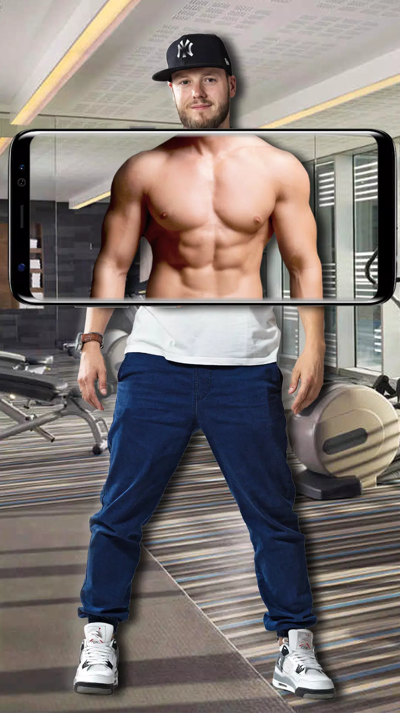
Body Filter
James Choi,
Leo Fernando Tan,
Peter

Slide 2
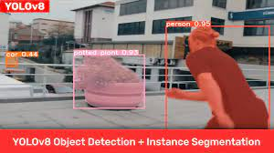
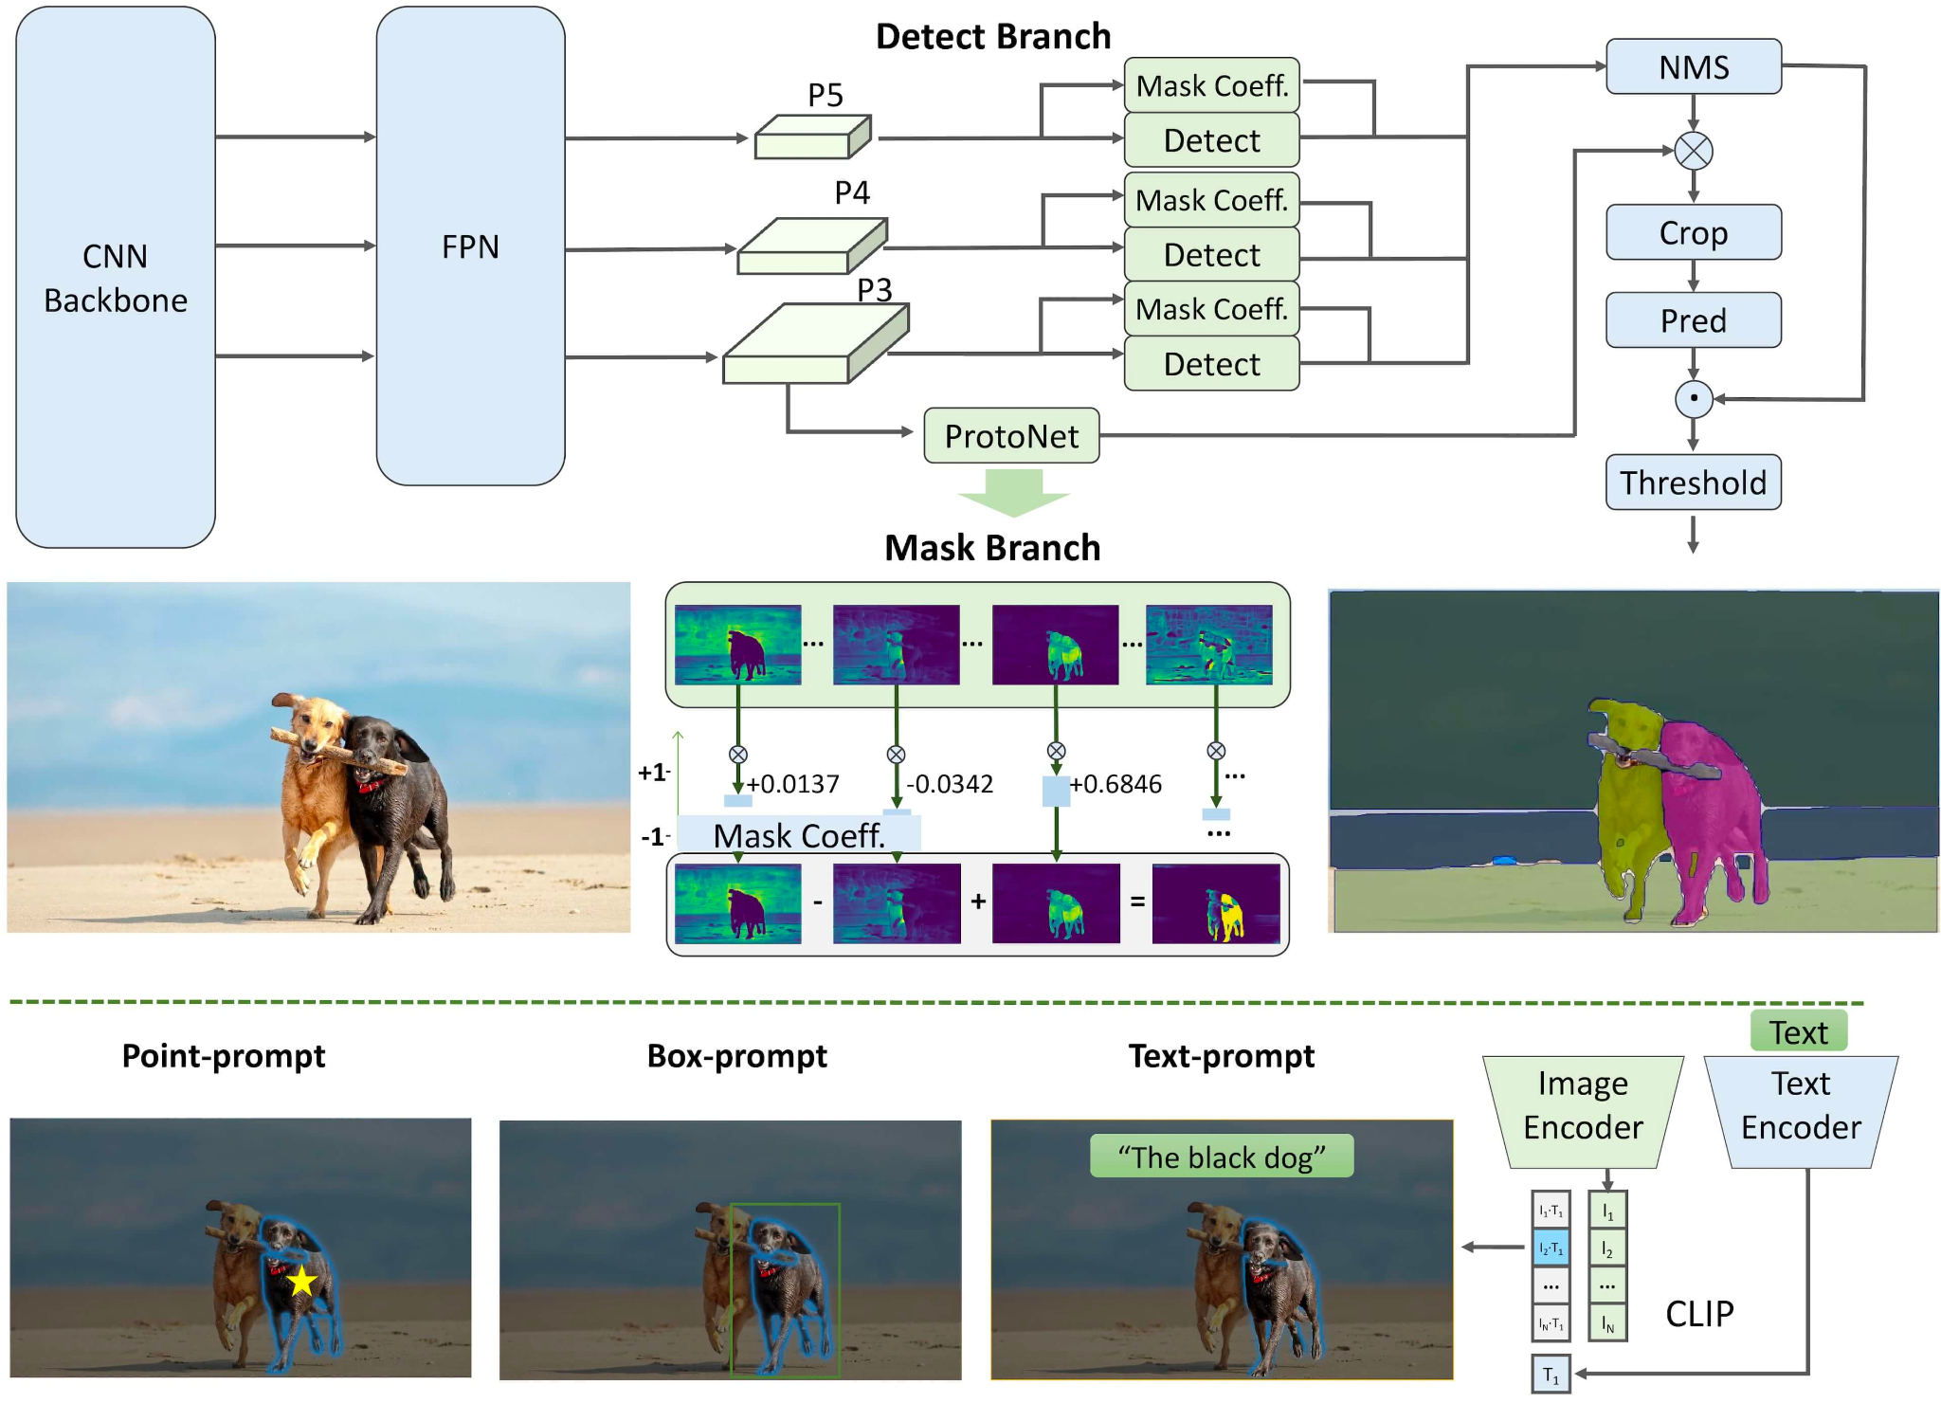

Libraries Used

Slide 3
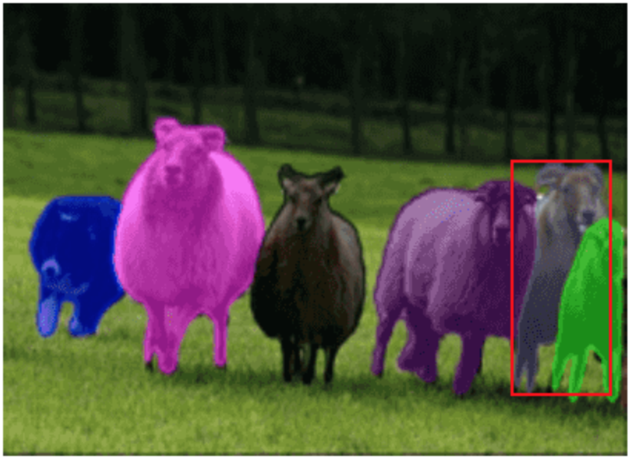
Main Technology
Segmentation

Slide 4
Possible Modifications
imgsz (Image Size for Training)
text_prompt(Which object to filter)
model_path (Which training weights to use for classification)
r,g,b (RGB values for filter)
Gaussian Blur (Apply Gaussian Blur)
conf (Model Confidence)
with_contours (Apply Contours)
with_boxes (Apply Bounding Boxes)

Slide 5
DEMONSTRATION

Slide 6
Restrictions
Speed
Accuracy
Number of filters

Slide 7

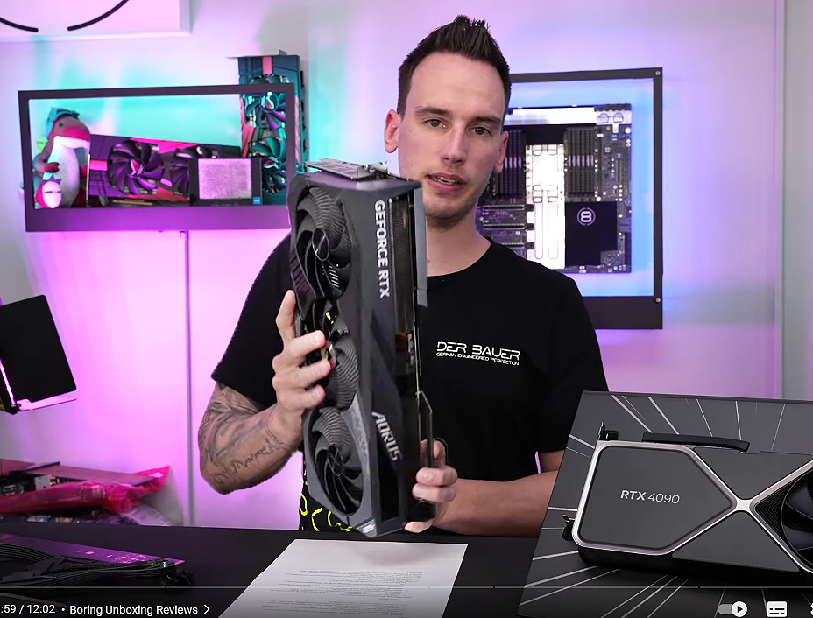
Possible Solutions
AWS (Cloud Services)
$$$$ GPU

Slide 8
Thank You!

